Slide 1
Lending club case study
Present by
RAJ KUMAR
PANKAJ YADAV

Slide 2
AGENDA
objective
Table of content
​technology used
Graph presentation
- conclusion

Slide 3
objective
- The main objective is to be able to identify these risky loan applicants, then such loans can be reduced thereby cutting down the amount of credit loss. Identification of such applicants using EDA is the aim of this case study.

Slide 4
Table of content
GENERAL INFO
STEPS TO BE USE
GRAPH WORK

Slide 5
GENERAL INFO
Help to identify the defaulter so we can prevent them from loan request in future so bank face little loss on that time

Slide 6
Lending club case study
TECHNOLOGY USED
PANDAS
NUMPY
MATPLOTLIB
SEABORN
STEPS
Step 1: Data Cleaning 1
Step 2: Univariate Analysis
Step 3: Segemented Univariate Analysis
. Step 4:Bivaraiate/Multivariate Analysis
Step 5: Results
.

Slide 7
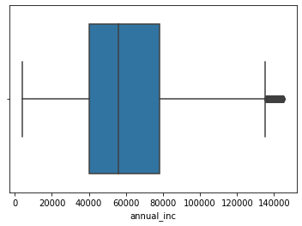
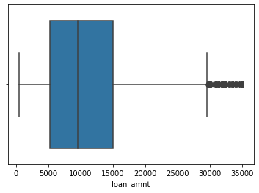

GRAPH PRESENTATIOn boxplot presentation funded amount
annual income
loan amount

Slide 8
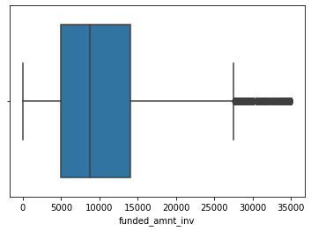
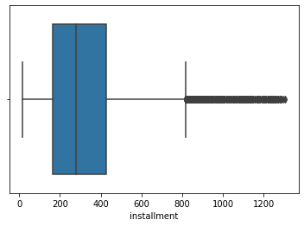
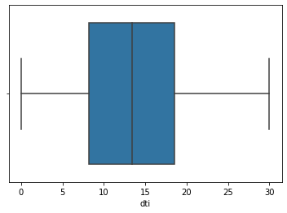
Boxplot graph
Funded amount by
investor
Installement payment
Total monthly debt payment

Slide 9
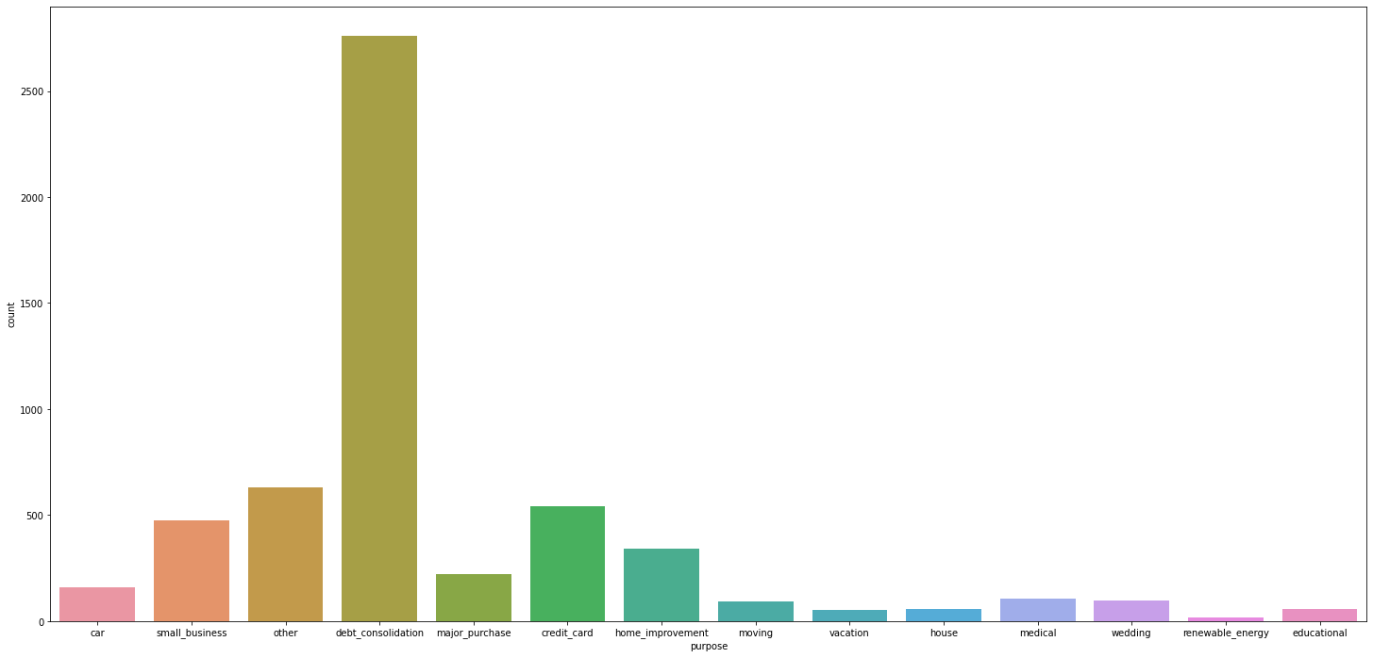
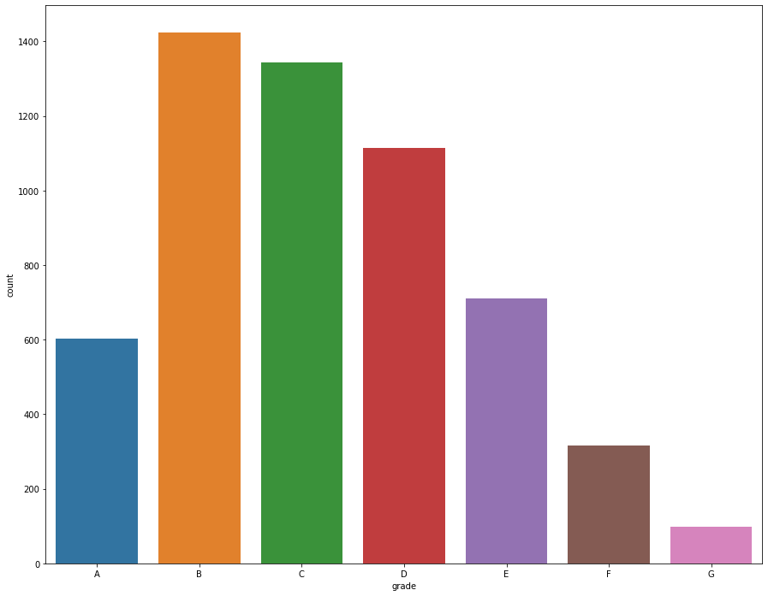
Graph presentation grade
purpose

Slide 10
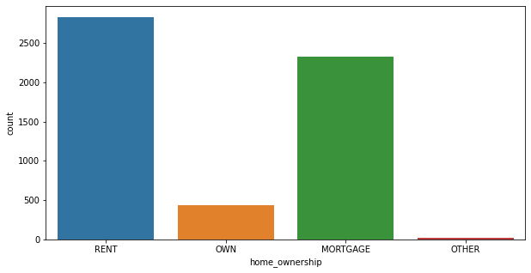
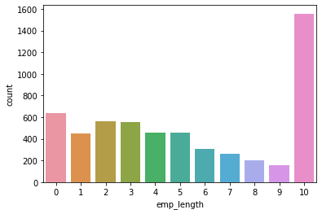
Graph with variable
Home ownership
Empolyer length

Slide 11
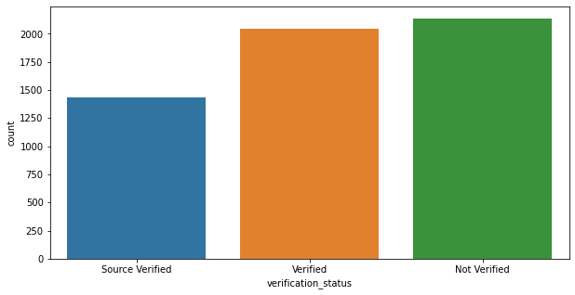
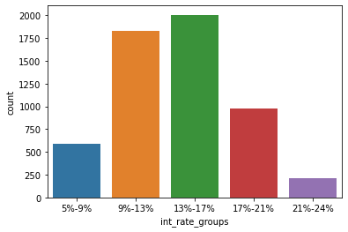
Graph analyze
verified or non verified
Interest rate group

Slide 12
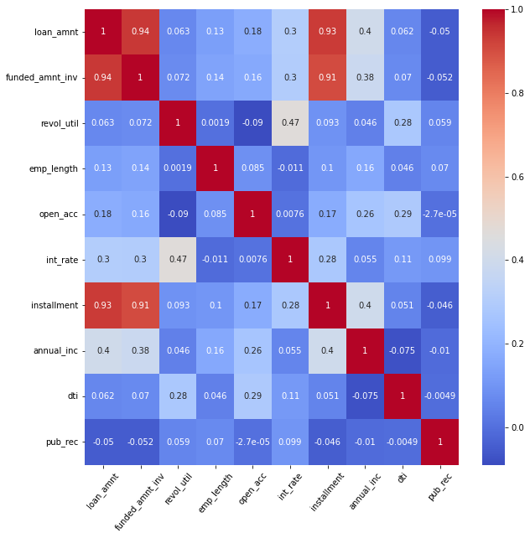
Correlation metrix

Slide 17
AREAS OF FOCUS
B2B MARKET SCENARIOS
CLOUD-BASED OPPORTUNITIES
Develop winning strategies to keep ahead of the competition
Capitalize on low-hanging fruit to identify a ballpark value
Visualize customer directed convergence
Iterative approaches to corporate strategy
Establish a management framework from the inside

Slide 18
SUMMARY
At Contoso, we believe in giving 110%. By using our next-generation data architecture, we help organizations virtually manage agile workflows. We thrive because of our market knowledge and great team behind our product. As our CEO says, "Efficiencies will come from proactively transforming how we do business."

Slide 19
THANK YOU
Mirjam Nilsson​
mirjam@contoso.com
www.contoso.com

